Slide 1

Career Pathways
LCPS School Improvement Task Force Committee
February 2015

Slide 2
Welcome
Dr. Deborah Grimes Vice President of Academic and Student Services
and
Holly Ball LCPS Secondary Curriculum Coordinator

Slide 3
High School Subcommittee
Goal 2: LCPS students will all have the opportunity to complete two years of college work while in high school.
Goal 3: LCPS students will enter into the ninth grade ready to complete their core high school classes within the first five semesters of high school.

Slide 4
Recommendations
May 2014
Consider a recommendation for the Middle School Subcommittee (Goals 4 and 5) to incorporate career exploration in the middle schools to advance students’ transition to high school and prepare them to choose a program of study or pathway.

Slide 5
Recommendations
May 2014
Consider the following curriculum standards/pathways to provide all students the opportunity to complete two years of college work while in high school.

Slide 6
Curriculum Standards/Pathways
Agricultural/Food/ Natural Resources
Business/Industry
General Education (Transfer programs – Associate in Arts, Associate in Science, AP, IB)
Health Sciences
Agricultural/Food/ Natural Resources
Business/Industry
Cultural Arts/
Fine Arts
Health Sciences
Public Safety
STEM

Slide 7
Progress to Date
Reviewed curriculum standards/pathways
Reviewed Career and Technical Education (CTE) 16 career clusters
Reviewed North Carolina Community College System (NCCCS) Combined Course Library and Curriculum Standards and programs of study
Reviewed Department of Labor and NCWorks.gov’s labor market projections to determine future demand for occupations

Slide 8
14 Career Pathways
Computer Integrated Machining
General Teacher
Networking Technology
Nurse
Sustainable Agriculture
Sustainability Technologies
Welding Technology
Accounting
Associate in Arts
Associate in Science
Automotive Customizing
Automotive Systems
Business Administration
Computer Engineering

Slide 9
Summary of Curriculum Standards/Pathways
Course requirements to complete a high school diploma
Course and hour requirements for completion of a certificate, diploma, or degree
Opportunities to earn additional college credit with NC High School to Community College Articulated Credit
Opportunities to complete a certificate, diploma or degree
Job opportunities for credentials earned and hourly/yearly potential earnings
Opportunities to earn transferrable credit to any NC Community College or UNC System School

Slide 10
Education Pays
Unemployment rate in 2012 (%)
Median weekly earnings in 2012 ($)
2.5
2.1
3.5
4.5
6.2
7.7
8.3
12.4
Doctoral degree
Professional degree
Master’s degree
Bachelor’s degree
Associate’s degree
Some college,
no degree
High school diploma
Less that a high school diploma
1,624
1,735
1,300
1,066
785
727
652
471
All workers: 6.8%
All workers: $815
Source: Bureau of Labor Statistics, Current Population Survey

Slide 11



Slide 12
What does this mean for students?
PRIVATE COLLEGES
Barton | $35,570
Meredith | $41,656
Mount Olive | $25,000
Average Cost | $34,075
PUBLIC UNIVERSITIES
NC State | $22,954
UNC at Chapel Hill | $24,120
East Carolina | $21,102
Average Cost | $22,725
COMMUNITY COLLEGES
Lenoir Community College | $2,423
YOUR SAVINGS
Compared to Private | $31,652
Compared to Public | $20,302

Slide 13
What does this mean for students?
Opportunities to complete a certificate, diploma or degree
Opportunities to earn additional college credit with NC High School to Community College Articulated Credit
Opportunities to earn transferrable credit to any NC Community College or UNC System School
  Opportunity to learn a new skill set for the student who will be seeking employment upon high school graduation

Slide 14


Slide 15
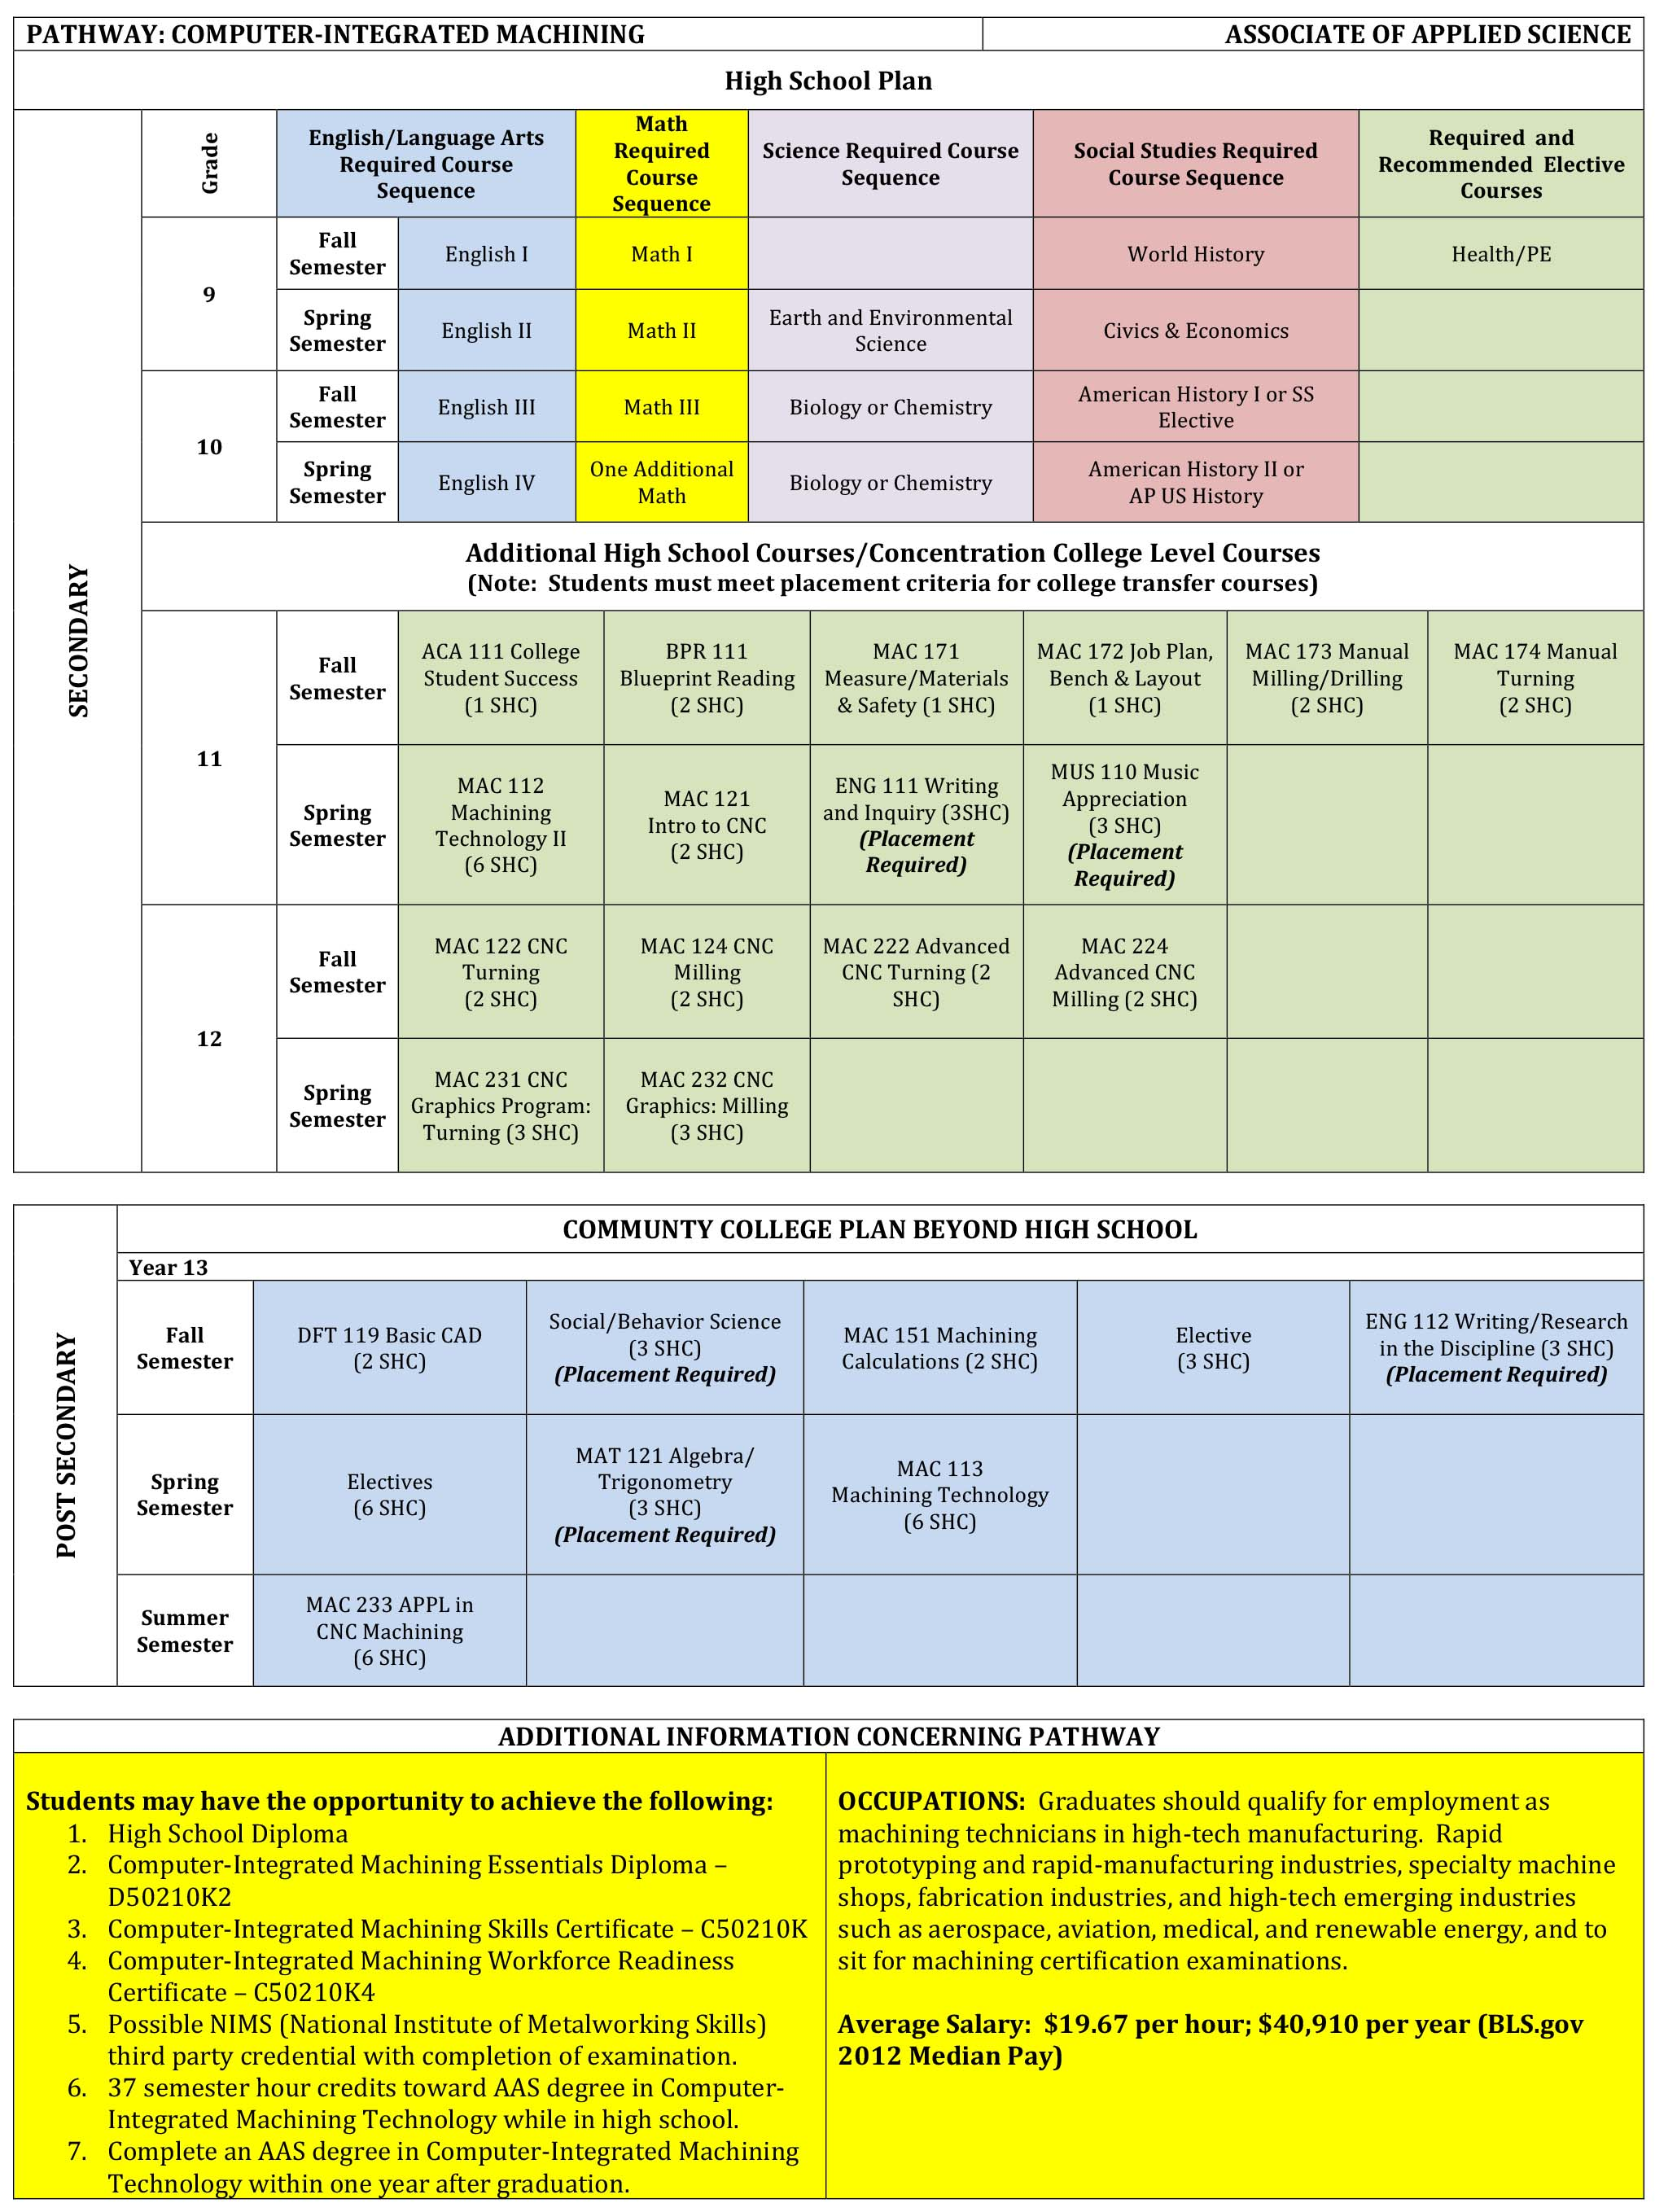
Pathways

Slide 16
Pathways

Slide 17
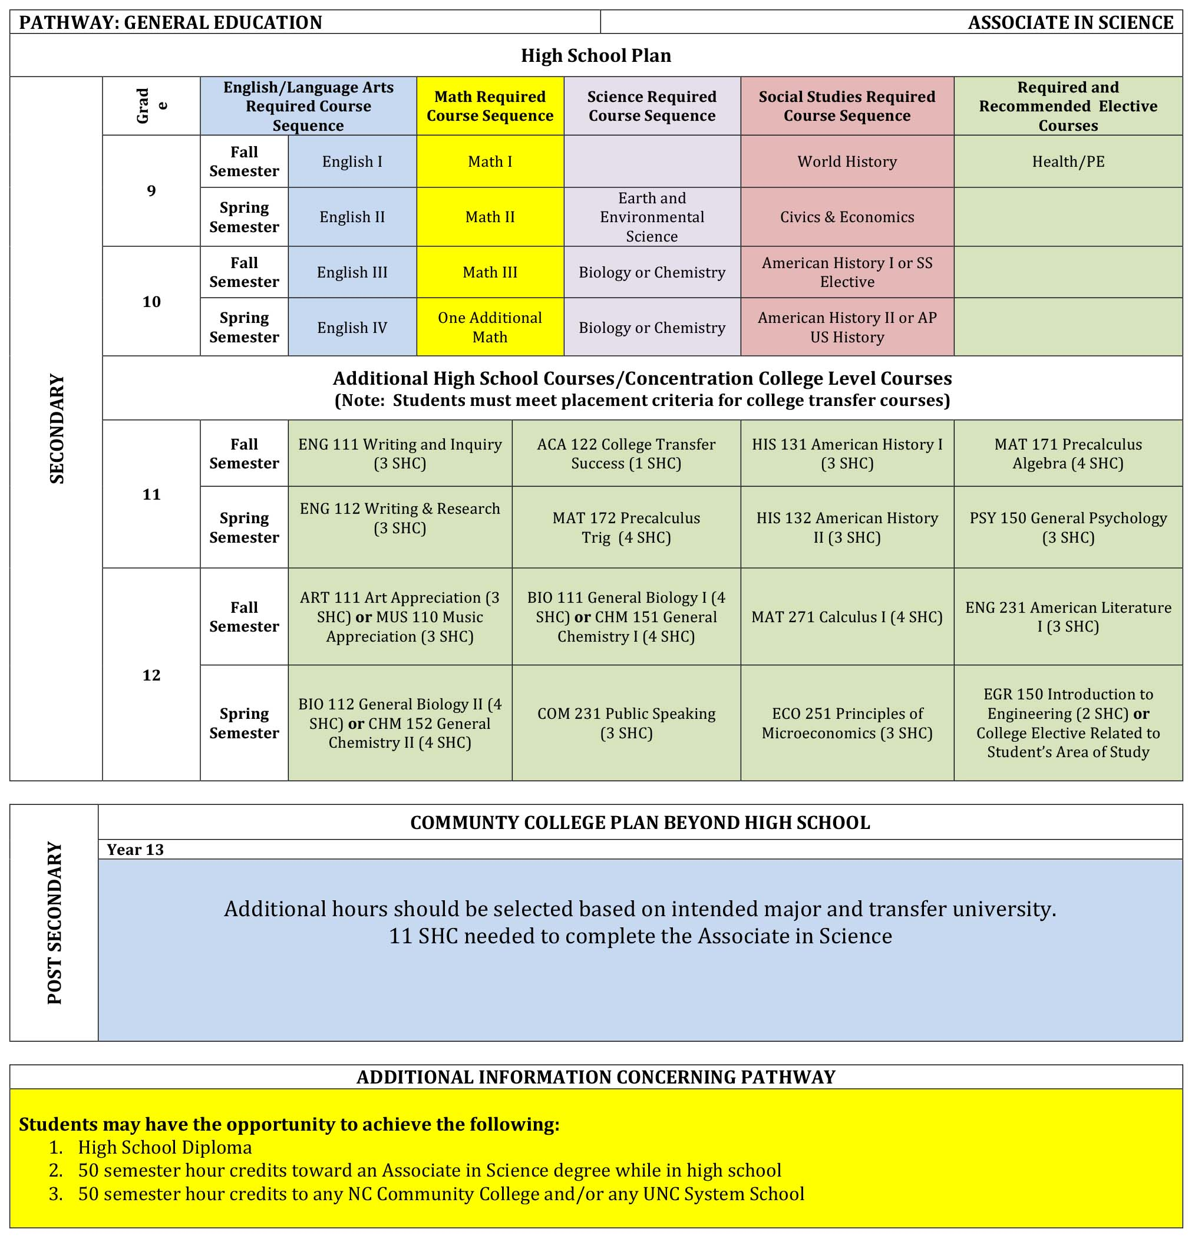
Pathways

Slide 18
Pathways

Slide 19
Student Eligibility Career Pathways
ALL students will have the opportunity to pursue a Career Pathway
Students and parents need to be informed of the eligibility requirements for students to be enrolled in any Career and College Promise Pathway for high school students

Slide 20
High School
Graduation Requirements
Core content requirements, including PE, are “front” loaded in the first two years of high school
High school Career and Technical Education (CTE) courses that enhance a pathway are included
Students will be able to meet their high school concentration in each pathway

Slide 21
Career and College Promise Eligibility
College Transfer Pathway (CTP)
  Be a high school junior or senior;
  Have a weighted a GPA of 3.0 on high school courses; and
  Demonstrate college readiness on a placement assessment
    Students who do not demonstrate college readiness on a placement assessment may be provisionally enrolled

Slide 22
Career and College Promise Eligibility
Career and Technical Education (CTE) Pathway
  Be a high school junior or senior;
  Have a weighted GPA of 3.0 on high school courses or have the recommendation of the high school principal; and
  Must meet the prerequisites of any course

Slide 23
Maintaining Eligibility
Career and College Promise
Continue to make progress towards high school graduation;
Maintain a 2.0 GPA in college coursework after completing two courses; and
Not have an established pattern of withdrawals from any other college courses after the drop/add deadline

Slide 24
Placement Assessment
Lenoir Community College (LCC) uses the NCDAP to assess students’ academic skills in English, reading, and math. The results help determine where a student should begin English and math courses at LCC.
Be Prepared.
http://www.lenoircc.edu/Student_Services/placeassess.htm

Slide 25
Importance of Planning
8th grade students
  Grade Point Average (GPA) begins the first year of high school
  GPA is a very important eligibility component in the Career Pathways

Slide 26
Importance of Planning
9th and 10th grade students
  GPA is a very important eligibility component in the Career Pathways
  Look at your current GPA and plan accordingly

Slide 27
Current Quality Points for
Lenoir County Public Schools
A grade of A in any standard level course = a GPA of 4.0
A grade of A for a college course = an additional quality point. A = GPA of 5.0

Slide 28
2015-2016
Honors courses = 0.5 quality points
Advance Placement (AP), International Baccalaureate (IB), College courses = 1.0 quality points

Slide 29
Grade Point Average (GPA) for
Lenoir Community College
A – 4 quality points per semester hour credit (SHC)
B – 3 quality points per SHC
C - 2 quality points per SHC
D - 1 quality points SHC
F - 0 quality points SHC

Slide 30
Pay Attention
“Regular and punctual attendance is the greatest factor in school success.”
Reduce the number of Absences

Slide 31
Frequent Questions
What if my student changes their mind and wants to pursue a different Career Pathway?
  Students are not “locked” into a Career Pathway. If students want to change their Career Pathway to another Career Pathway, they may do so. Counselors will work with students to adjust their course schedules accordingly.
What if my student does not meet eligibility requirements for the college courses?
  Counselors will work with students to adjust their course schedules accordingly.

Slide 32
We appreciate your attendance.
Questions?

