Slide 1
WHAT IS 21st CENTURY LITERACY?
MARIA DELGADO
LENOIR COUNTY PUBLIC SCHOOLS

Slide 2
WHO?
CITIZENS
WE ARE ALL CITIZENS
DO YOU KNOW HOW TO CONTACT YOUR LEGISLATORS?

Slide 3
WHO?
PARENTS, CHILDREN, YOUNG AND OLD, FEMALE AND MALE.

Slide 4
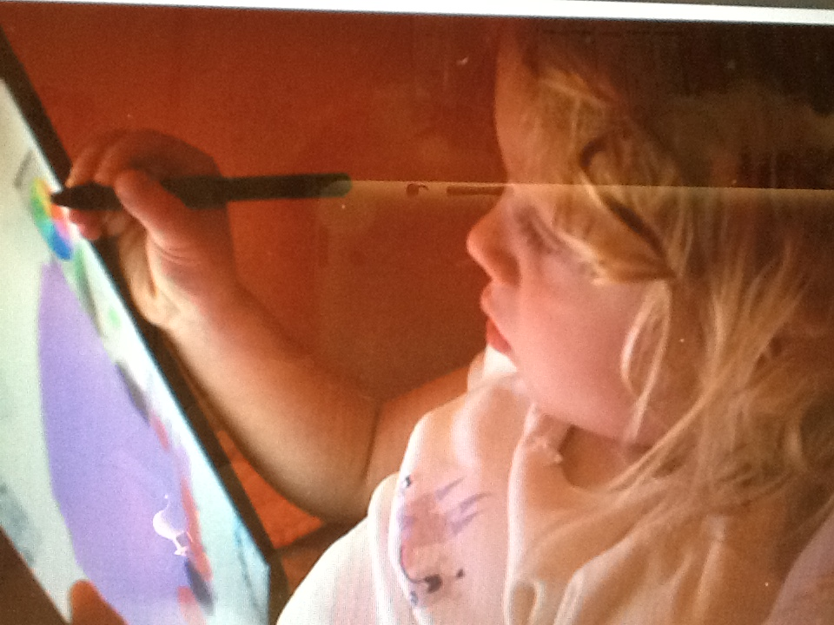
WHO?
EDUCATORS & STUDENTS

Slide 5
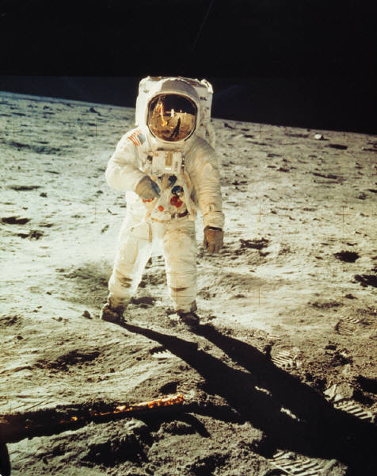
WHO
THE WORKFORCE

Slide 6
WHO
TEACHERS WHO USE TECHNOLOGY IN THEIR PERSONAL LIVES WILL USE IT IN THEIR CLASSES.

Slide 7
WHO
TEACHERS NEED TO BE EXPERTS IN TECHNOLOGY IN ORDER TO USE IT EFFECTIVELY IN INSTRUCTION

Slide 8
“ The illiterate of the 21st century wil not be those who cannot read and write, but those who cannot learn, unlearn, and relearn.”
Alvin Toffler, Rethinking the Future.

Slide 9
INFORMATION LITERACY
“Simply going to the library or using the Internet to find facts about a topic does little to encourage learning in an information-rich world.Real life is about problem-solving and decision-making. It is more than reporting facts”
The Philadelphia Inquirer, April 20, 2000

Slide 10
Basic skills for many types of literacy

Slide 11
SCENE 1: 20TH CENTURY CLASSROOM

Slide 13
FORMATIVE WHAT…?

Slide 14
SCENE 2: 21ST CENTURY CLASSROOM
TODAY WE ARE CRITICAL THINKERS

Slide 15
TODAY WE COLLABORATE

Slide 16
TODAY WE COMMUNICATE WITH THE REST OF THE WORLD

Slide 17
DO YOU SEE THE DIFFERENCE?
SMILE IF YOUR ANSWER IS YES

Slide 18
WHO IS INVOLVED IN THIS CHANGE?

Slide 19
EVERYBODY
We are all citizens
Do your students know how to communicate with their legislators?
Do they know their legislators?

Slide 20
“the demands of 21st century literacy are more complex and challenging than those of 18th-century literacy…” Kylene Beers NCTEvice president

Slide 21
HOW ARE WE GOING TO DO IT?

Slide 22
The Common Core State Standards provide a consistent, clear understanding of what students are expected to learn, so teachers and parents know what they need to do to help them.

Slide 23
The standards are designed to be robust and relevant to the real world, reflecting the knowledge and skills that our young people need for success in college and careers. With American students fully prepared for the future, our communities will be best positioned to compete successfully in the global economy.

Slide 24
TODAY WE LEARN, CREATE & COLLABORATE
8TH GRADERS AT WOODINGTON

Slide 25
21st Century students understand other perspectives and cultures

